Slide 1
Building Applications for Relativity and RelativityOne

Slide 2
Chandra Alimeti
Maria Marinova
Carlos Torres

Slide 3
Relativity Templates
Publish to Relativity
Unit Tests
Integration Tests
Run Integration Tests as CI
Gravity API

Slide 4
Enter your email address in the workshop portal website.
Select Workshops section.
Select Building Applications for Relativity and RelativityOne workshop.
A Remote Desktop Connection will be downloaded.
Enter the following credentials to login to the workshop instance
Login: .\csadmin
Password: R31@tivity!!
Connect to Workshop Instance

Slide 5
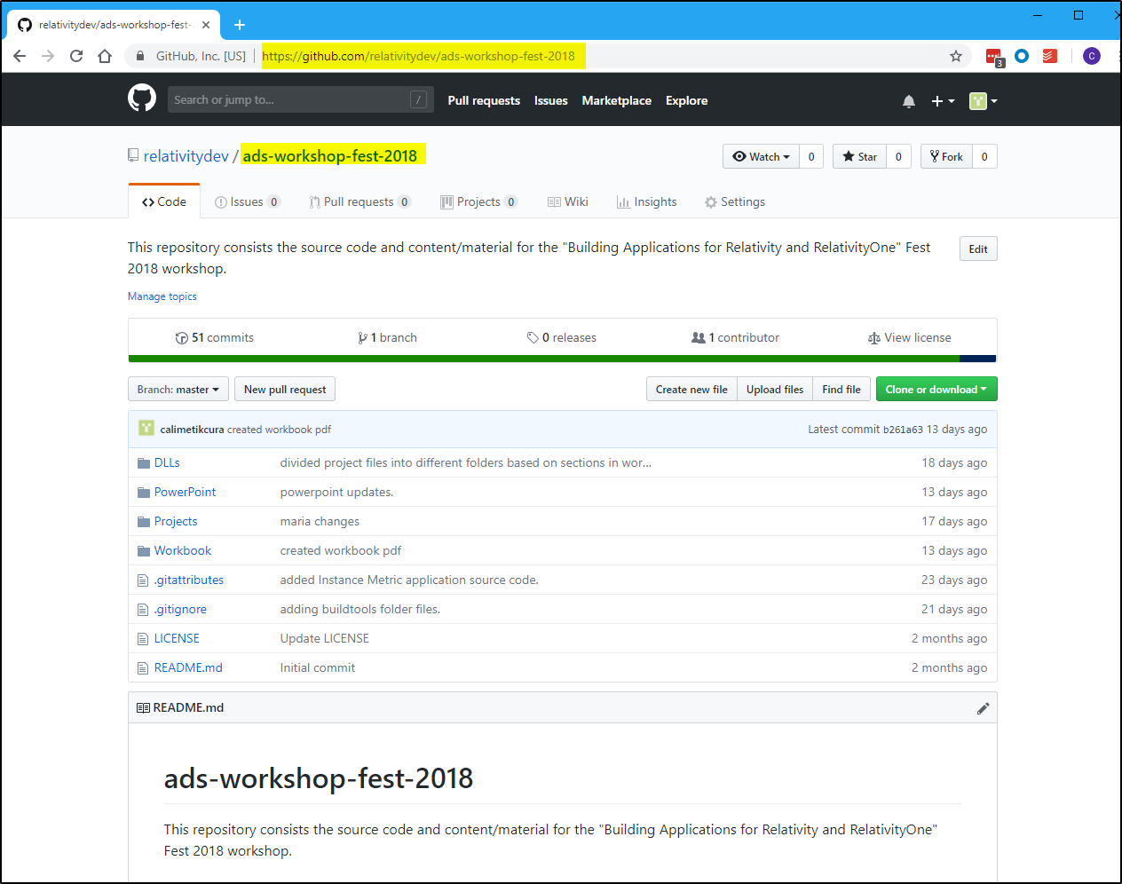
All the content for this workshop is available on Github at this link
https://github.com/relativitydev/ads-workshop-fest-2018
Content

Slide 6
Open PowerShell on your remote instance.
Navigate to workshop Github repository folder by running the following command.
Command:
cd E:\Github\ads-workshop-fest-2018
Run the following command to pull the latest changes in the Github repository.
Command:
git pull
Close the PowerShell window
Download latest changes

Slide 7
Getting Started

Slide 8
You should see a PDF on your workshop machine’s desktop.
This document contains all the instructions for today’s workshop.
Workbook
Document

Slide 9
Follow instructions on Section 2.1 on Page 4 to access the various projects that will be used in the workshop.
Workshop Projects

Slide 10
Follow instructions in Section 2.2 on Page 5 to setup DevVM for accessing Relativity.
DevVM Setup

Slide 11
Visual Studio Templates

Slide 12
Visual Studio project templates + NuGet Packages
Creating a Relativity Application
Develop a Relativity Event Handler
Publish to Relativity
Section Overview

Slide 13
Pre-created class files
Overridable functions
Auto-filled class attributes
GUID
Execution type
Version specific
Generally work across versions
Visual Studio Marketplace
Visual Studio project templates

Slide 14
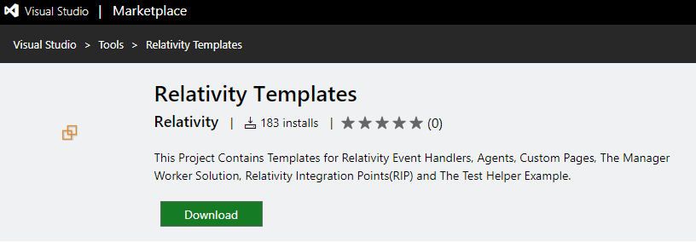
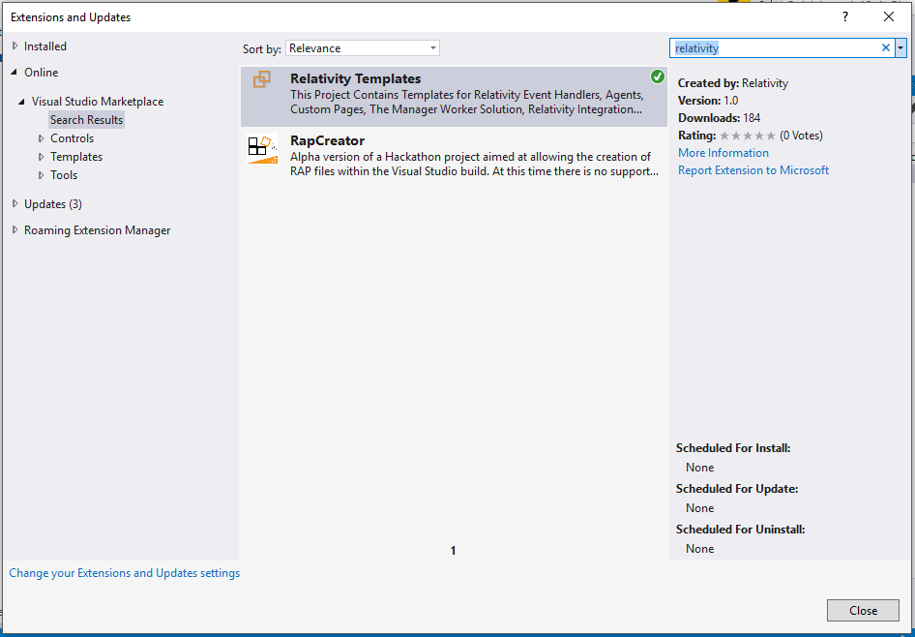
Visual Studio project templates

Slide 15
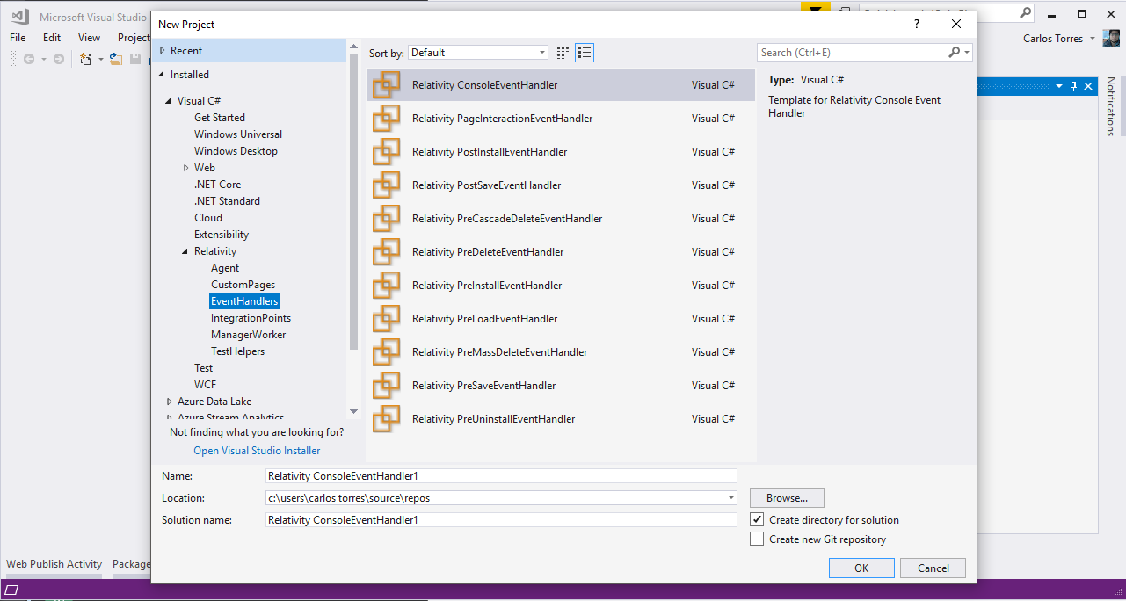
Visual Studio project templates

Slide 16
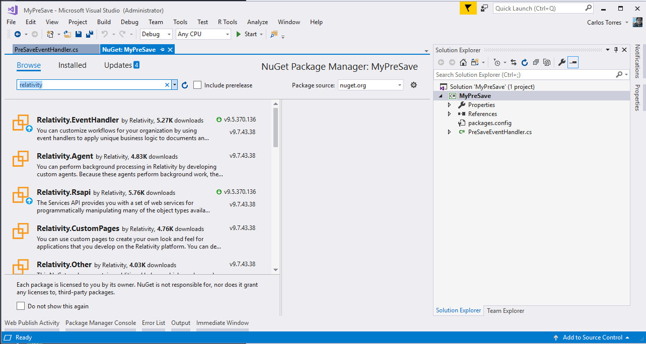
NuGet packages

Slide 17
Extend Relativity
Customized workflows
Custom Objects (RDOs)
Extensibility Points
Event Handlers
Agents
Custom Pages
Exportable to other workspaces/instances
Relativity Applications
Overview

Slide 18
Event handlers
Pre/post save
Pre/post install
Page interaction
Agents
Background processes
Custom page
Customize UI
Extensibility Points Overview

Slide 19
Quick upload of application files
Resource files
Custom pages
Set your configuration and publish with a Click!
Publish to Relativity

Slide 20
Visual Studio Templates
Section 3 Page 9

Slide 21
Create a Relativity Application
"Build your first application"
Develop a Relativity Event Handler
"Build your first event handler"
Visual Studio Templates
"Visual Studio templates"
Publish to Relativity
"Publish to Relativity tool"
Documentation
References

Slide 22
Sample Application

Slide 23
Sample Application Overview
Section Overview

Slide 24
The Sample Relativity application consists of the following
Custom Object
Instance Metrics Job
Fields
Metrics
Status
Workspaces Count
Users Count
Groups Count
Errors
Event Handler
PreSaveStatusUpdate
Agent
Instance Metrics Calculator Agent
Sample Application Overview

Slide 25
Sample Application
Section 4 Page 22

Slide 26
Unit Tests

Slide 27
Find software bugs early
Facilitates change
Simplifies integration
Provides documentation
Unit Tests

Slide 28
Set Up
Test
Arrange
Act
Assert
Tear Down
Unit Tests

Slide 29
Set Up
Setup Mocks
Setup RSAPI Repositories
Test
Golden Flow
Stub methods for Mocks
Run your unit of function under Test
Verify Stubs were called
Run Asserts / Exceptions
Tear Down
Delete Mocks
Unit Tests

Slide 30
Unit Tests
Section 5 Page 27

Slide 31
Integration Tests

Slide 32
Necessary to verify whether the software modules work in unity
Test custom applications when new versions of Relativity are released
RelativityOne and integration tests
Relativity test helpers for integration tests
Open source project on Github
https://github.com/relativitydev/relativity-test-helpers
Integration Tests

Slide 33
Set Up
Test
Arrange
Act
Assert
Tear Down
Integration Tests

Slide 34
Set Up
Setup Test Variables
Setup API Endpoints
Create Workspace where the application will be tested
Install Application
Setup Agents
Test
Golden Flow
Get Instance Workspaces, User and Group counts
Create Test Workspace
Create Test User
Create Test Group
Integration Tests

Slide 35
Test
Get Create Job
Run Job
Wait for the job to finish
Get Instance Workspaces, User and Group counts
Verify Instance Workspaces, User and Group counts
Delete Workspace
Delete Group
Delete User
Delete Job
Tear Down
Delete Agents
Delete Workspace
Integration Tests

Slide 36
Integration Tests
Section 6 Page 34

Slide 37
Gravity API

Slide 38
Developed by TSD
https://www.tsd.com/
Open source project on Github
https://github.com/tsdservices/gravity
CRUDQ Framework for Relativity Custom Development using .NET objects
Easy to work with as data is returned in the form of .NET objects; all the field conversions are done for you by Gravity.
Prevent any future issues caused by changes in Relativity APIs
NuGet package
https://www.nuget.org/packages/Gravity/
Gravity API

Slide 39
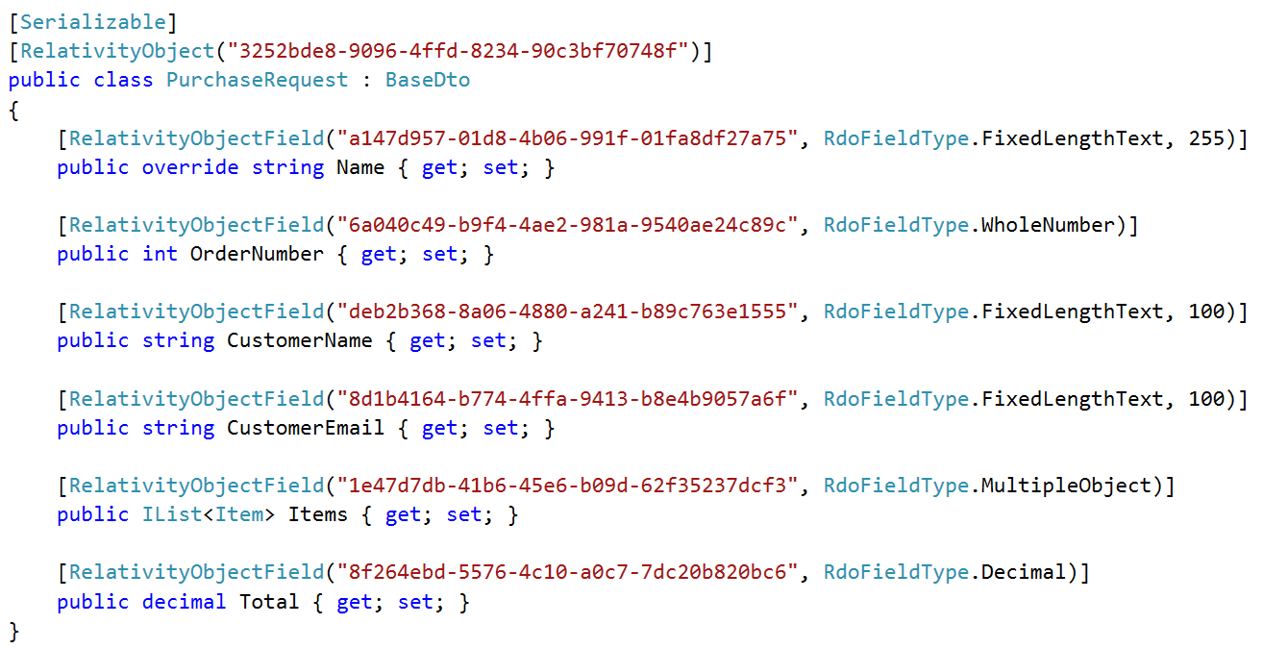
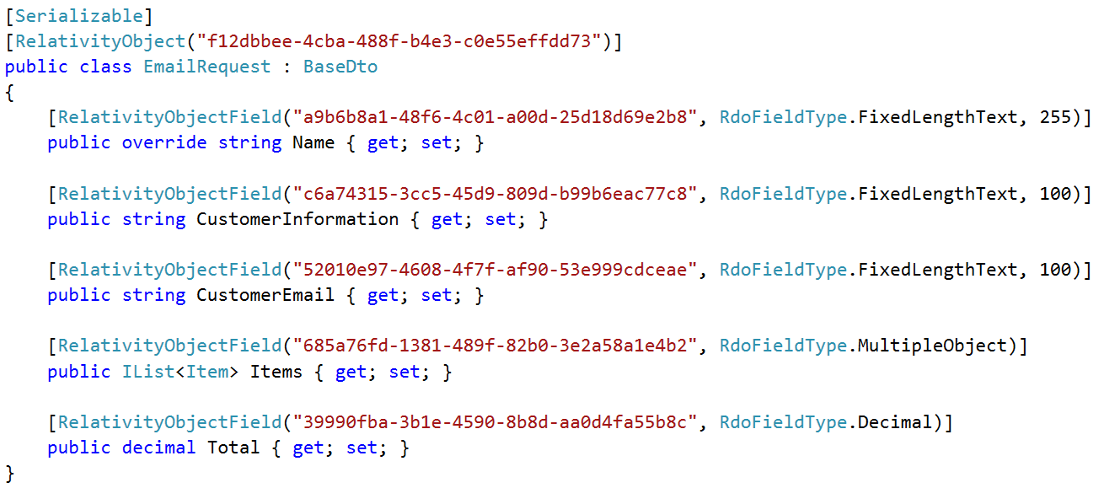
Example Models – PurchaseOrder & EmailRequest

Slide 40
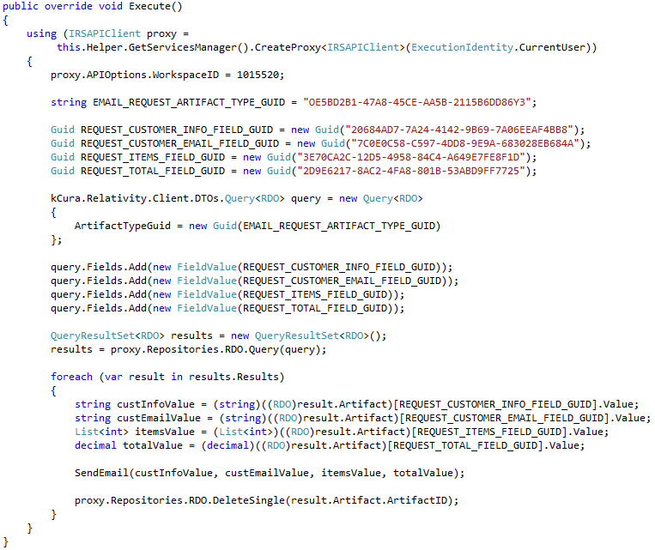
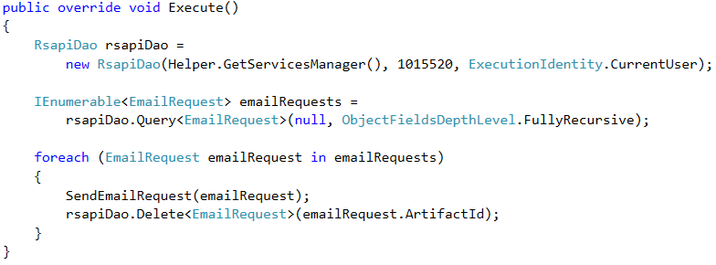
Before Gravity vs. After Gravity – (Agent Example)

Slide 41
Gravity API
Section 7 Page 44

Slide 42
Relativity One
Best Practices

Slide 43
Use API as much as possible
Audit table – No SQL access. You have to use the Datagrid Audit API
Extracted Test – No SQL access. Use Export API
Clean up files and tables on Application Uninstall
Sandbox access - Contact DevEx team
Write Unit and Integration tests and run them on DevVM and Early Access Sandbox.
Resources
https://platform.relativity.com/9.6/Content/RelativityOne/RelativityOne_developer_considerations.htm
Relativity One
Best Practices

Slide 44
Relativity Community (community.relativity.com)
Developer Group
DevHelp Community (devhelp.relativity.com)
RelativityDev GitHub (relativitydev.github.io)

Slide 47
Questions?

